Slide 1
Internship 2020
A.L.I.C.E.
Cornelius Yap, Tiffany Goh, Samuel Lye

Slide 2
Agenda
Overview of A.L.I.C.E.
Background - Analyzing Language Interface Created for Everyone (A.L.I.C.E.)
Key Components
- Frontend & Visualization Tools
- Machine Learning Algorithms
- DevOps (Docker & OpenShift)
Live Demo
Walkthrough of Use Case
Live Demo

Slide 3
Background
Automatic text summarization methods are greatly needed to address the ever-growing amount of text data available online to both better help discover relevant information and to consume relevant information faster.
Analyzing Language Interface Created for Everyone (A.L.I.C.E.) is purposed to summarize text documents and output informative visualization displays that quickly and easily communicate the contents of the text to the user.
The key components of A.L.I.C.E. are the Frontend (React, D3), Backend (Flask, Machine Learning models), as well as DevOps (Docker, Openshift).
Notes:
There is an enormous amount of textual material, and it is only growing every single day. Therefore, there is a great need to reduce much of this text data to shorter, focused summaries that capture the salient details, both so we can navigate it more effectively as well as check whether the larger documents contain the information that we are looking for.

Slide 4














Key Components
Database
Frontend and Visualization
Backend
Machine Learning Models

Slide 5
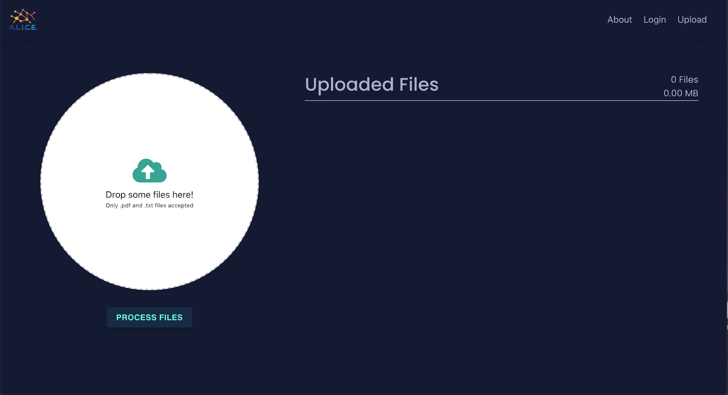
Walkthrough of Use Case

Slide 6
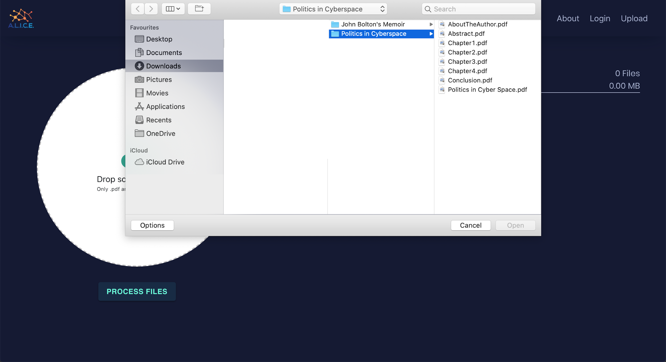
Walkthrough of Use Case

Slide 7
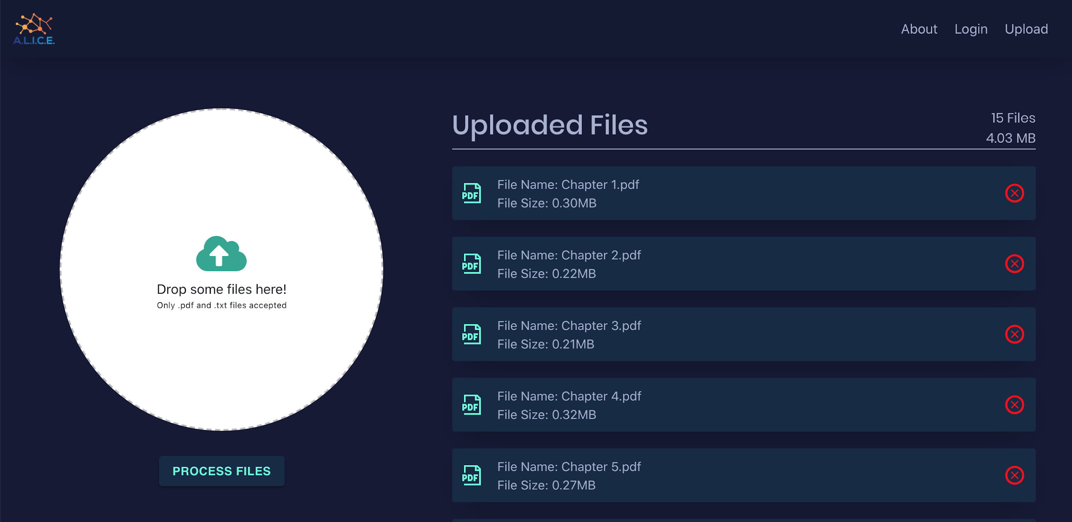
Walkthrough of Use Case

Slide 8
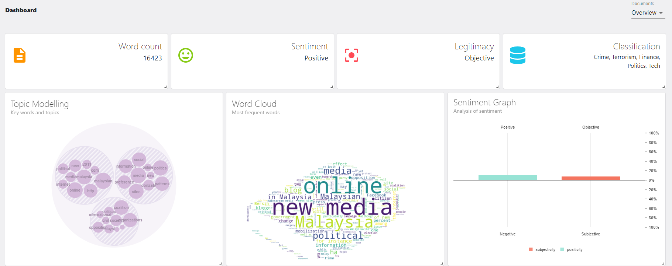
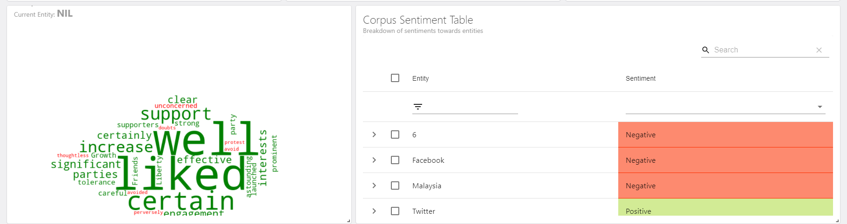
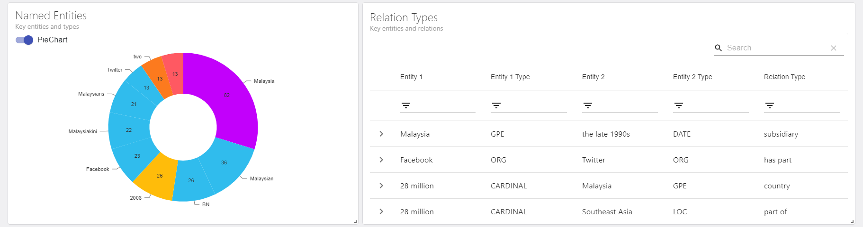
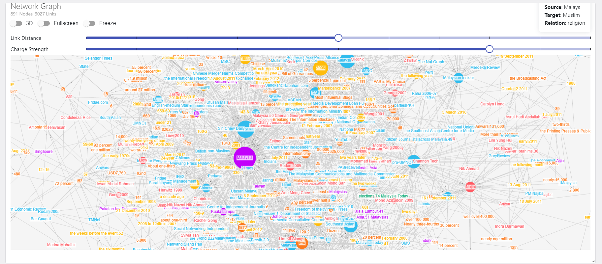
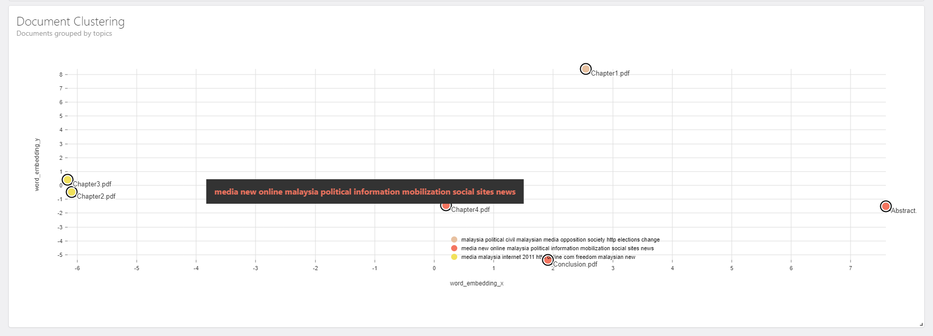
Key Data
Topic Modelling, Word Cloud, Sentiment Graph
Aspect-based sentiment Analysis
Named Entity Recognition, Relation Extraction
Network Graph
Document Clustering

Slide 9
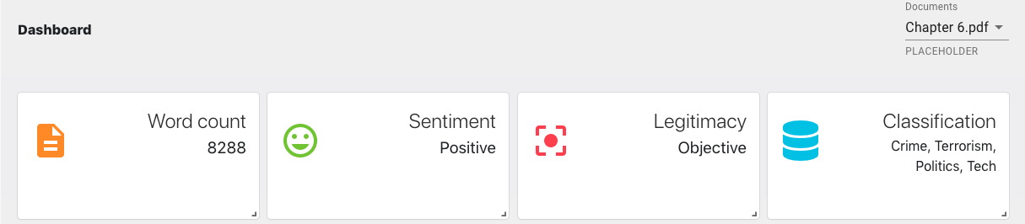
Walkthrough of Use Case
The key data provides a simple summary of the entire document or chapter.
For example, Chapter 6 of the document has 8288 words, has a positive sentiment, is written objectively, and has the classification of crime, terrorism, politics, and technology.

Slide 10
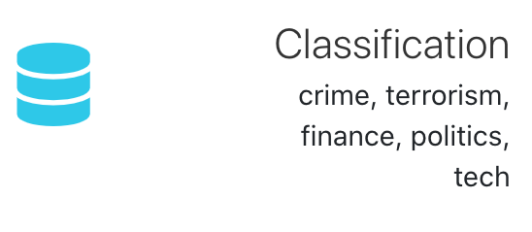
Walkthrough of Use Case
Classifies the document into any of the following six categories: Health, Crime, Terrorism, Finance, Politics and Tech

Slide 11
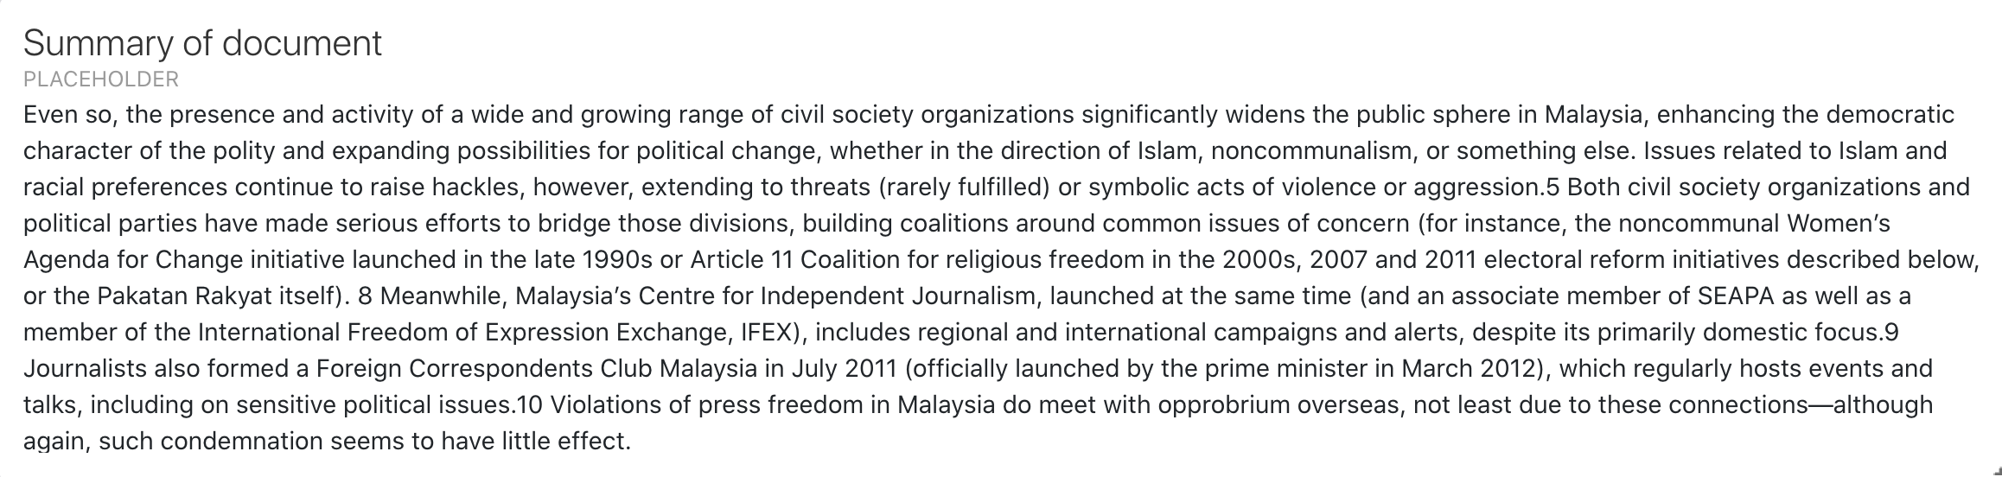
Walkthrough of Use Case
The text summarizer takes the most important sentences of the document as the summary. Currently the default settings displays 4-5 lines as the summary

Slide 12
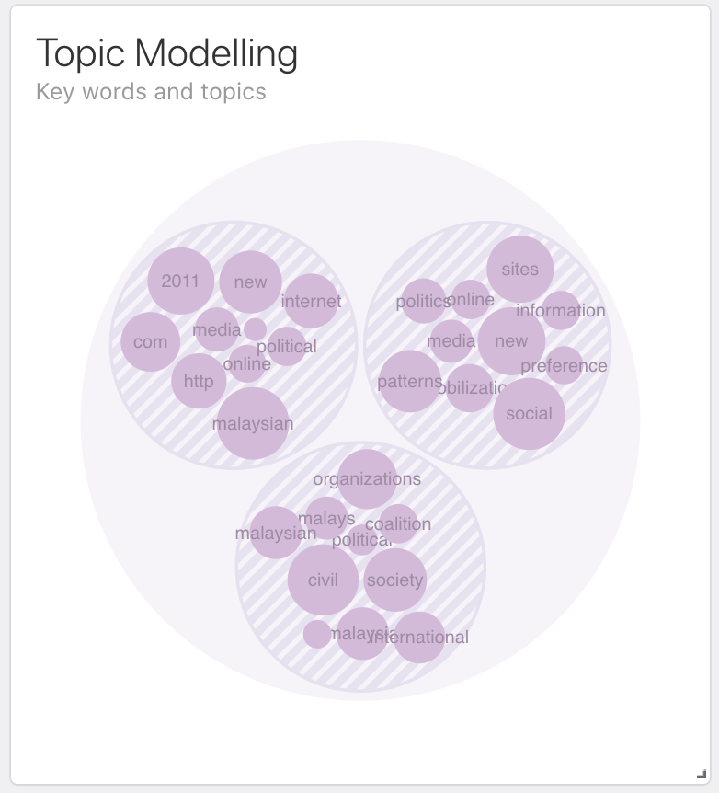
Walkthrough of Use Case
The larger bubble represents a topic and the smaller bubbles within it represents the words that make up the topic
The user has to infer what the topic is based on the words that are given

Slide 13
Walkthrough of Use Case
The word cloud is an image that is made up of the most frequent words in the document.
The larger the words, the higher the frequency count in the document.

Slide 14
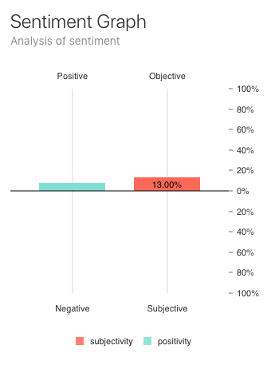
Walkthrough of Use Case
The sentiment graph provides more details about the positivity and subjectivity of the document.
The left bar represents the positivity.
The right bar represents the subjectivity.

Slide 15
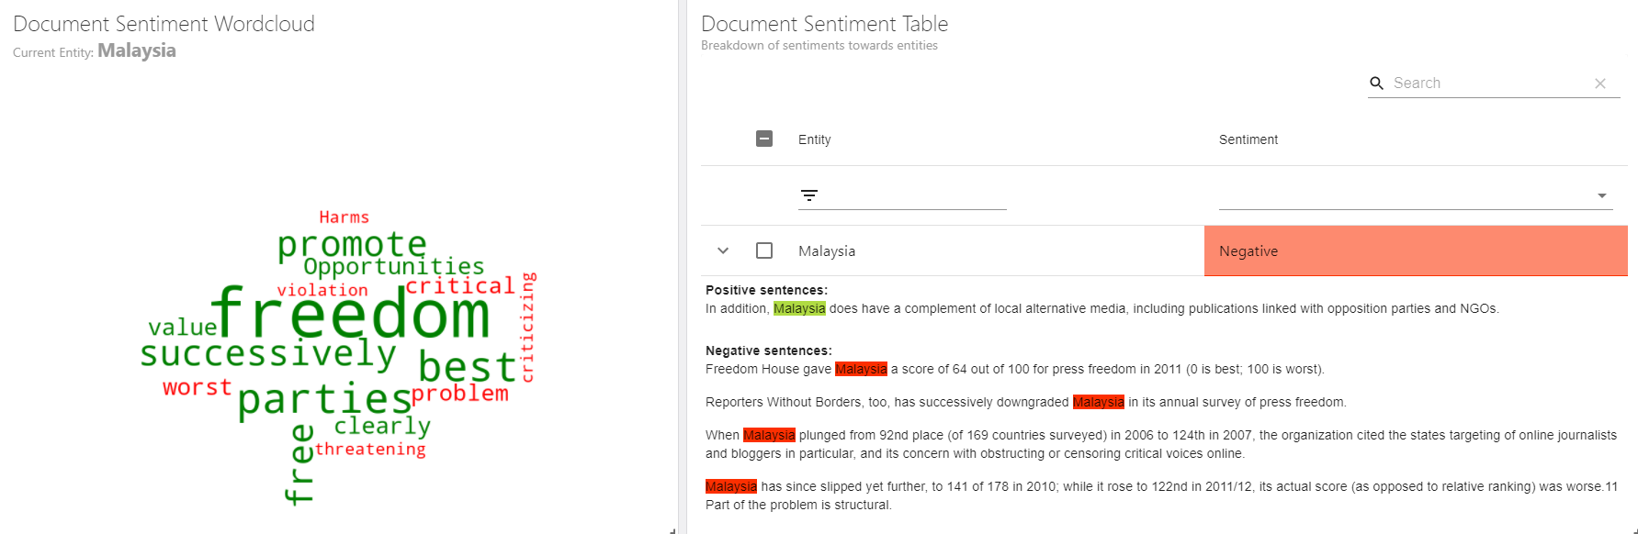
Walkthrough of Use Case
The Document Sentiment Table shows the sentiment towards the entity
The Document Sentiment Word Cloud highlights the positive and negative words surrounding the entity in the document

Slide 16
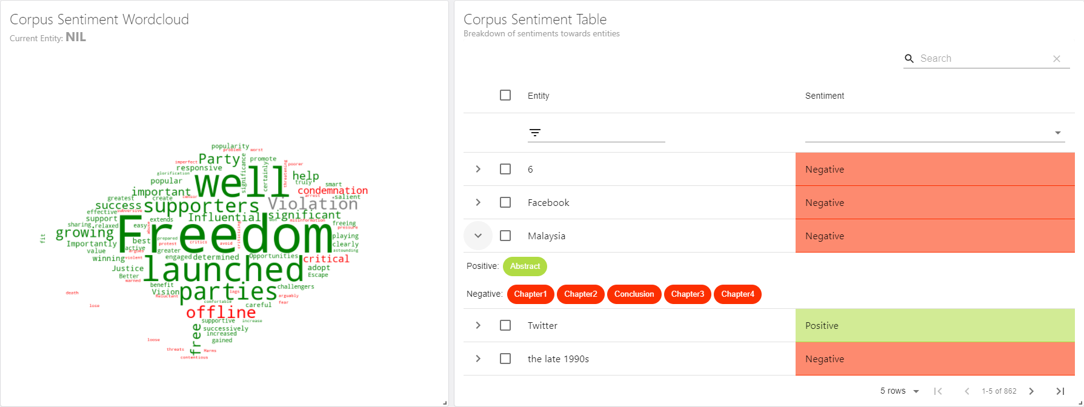
Walkthrough of Use Case
Sentiment analysis towards an entity is done at different granularity
Sentence level
Document level
Corpus level

Slide 17
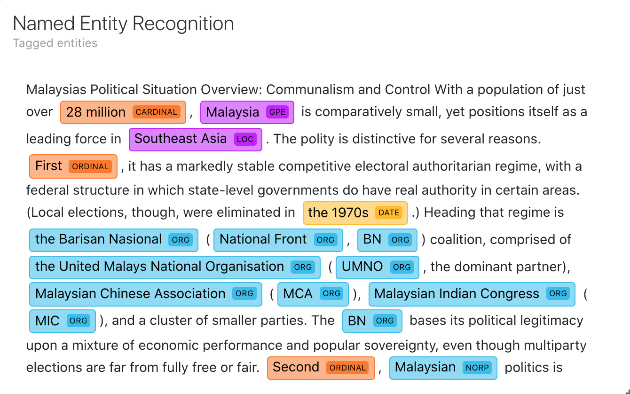
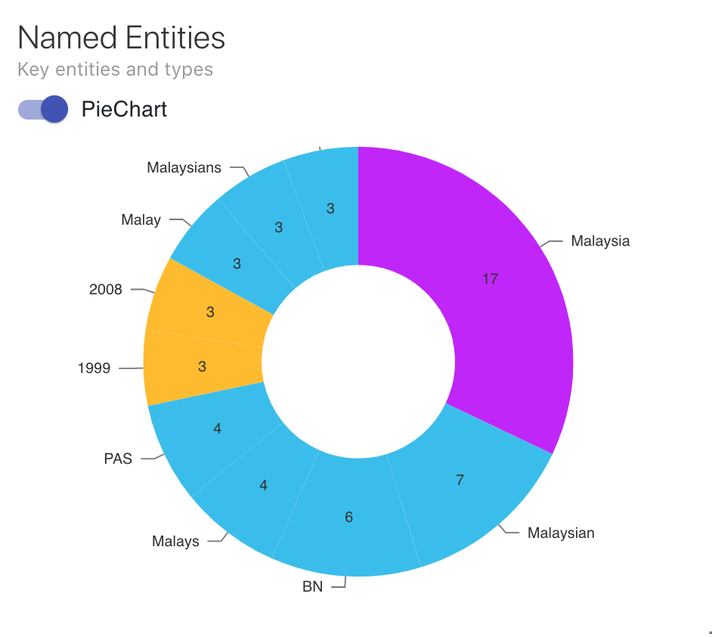
Walkthrough of Use Case
The entity visualizer highlights named entities and their labels in a text.
The entity pie chart displays the top 10 entities within the document, so that users can focus on the most frequent entities.

Slide 18
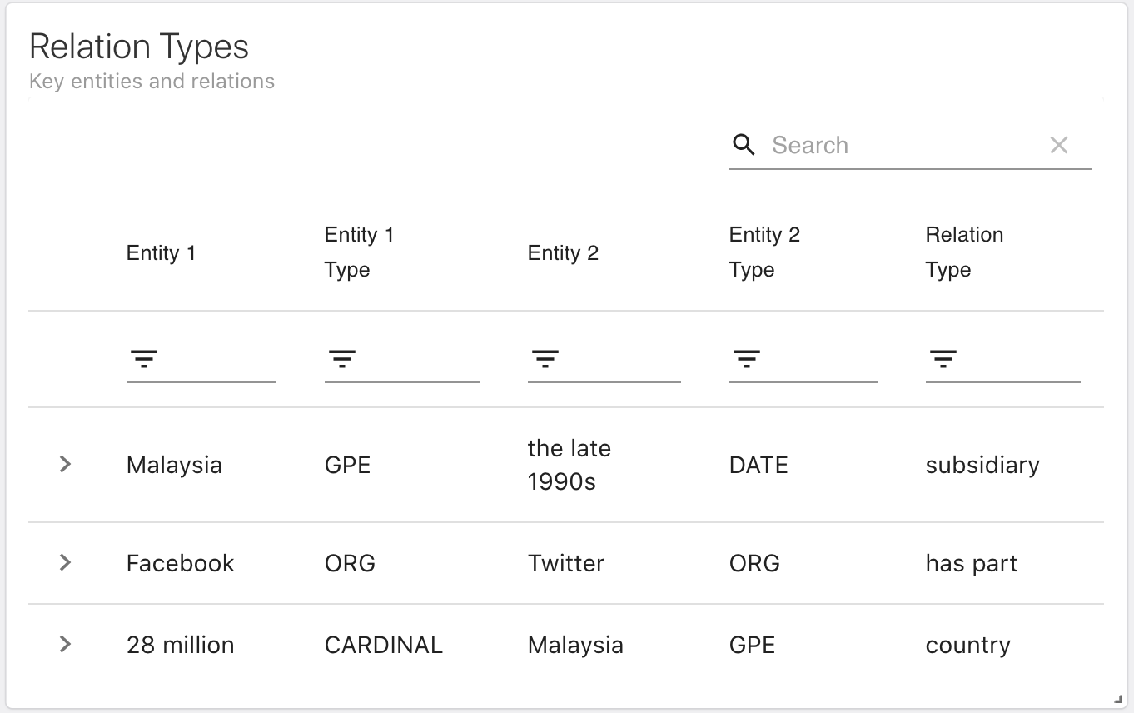
Walkthrough of Use Case
In the Overview dashboard, the relation table allows the user to know which document the relation appears in.
In the individual document dashboard, the filtering of entities in the network graph is done by the relation table because of the smaller scale of relations in the individual documents. Also, the relation table allows the user to delete the relation if it is irrelevant.

Slide 19
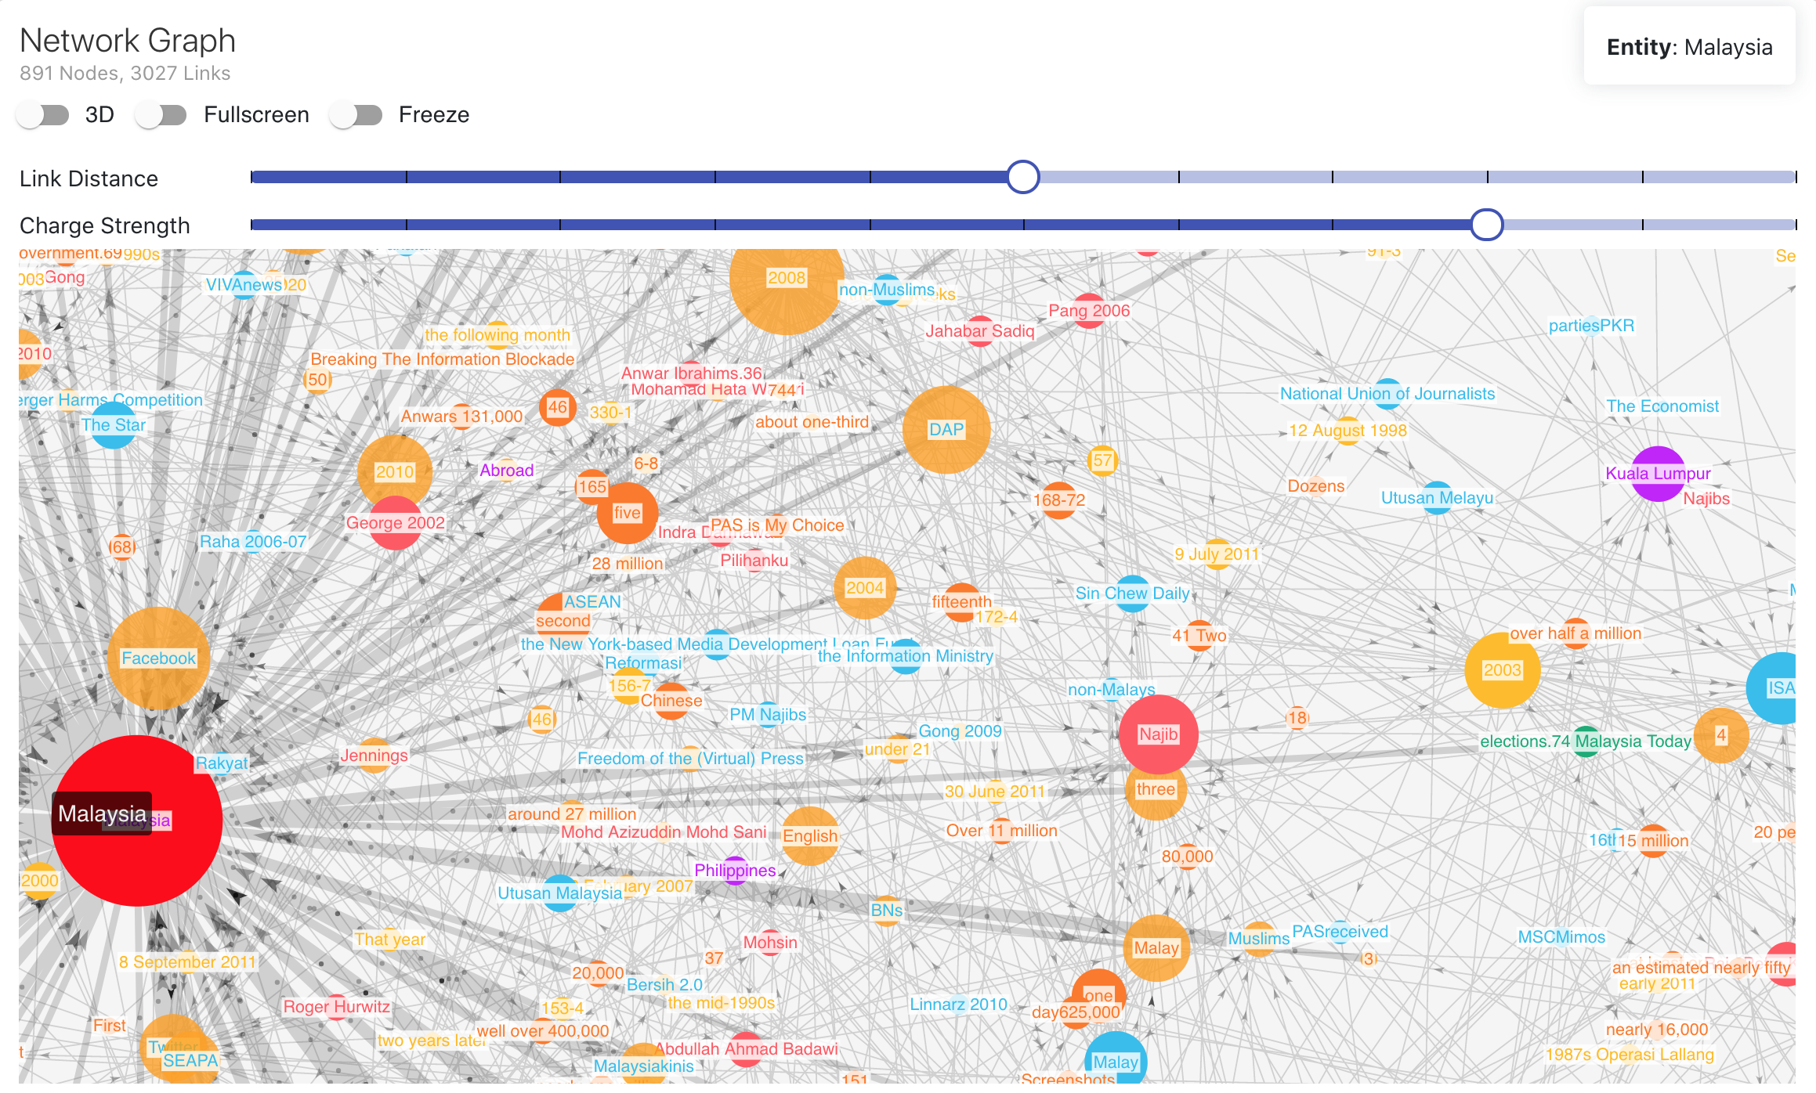
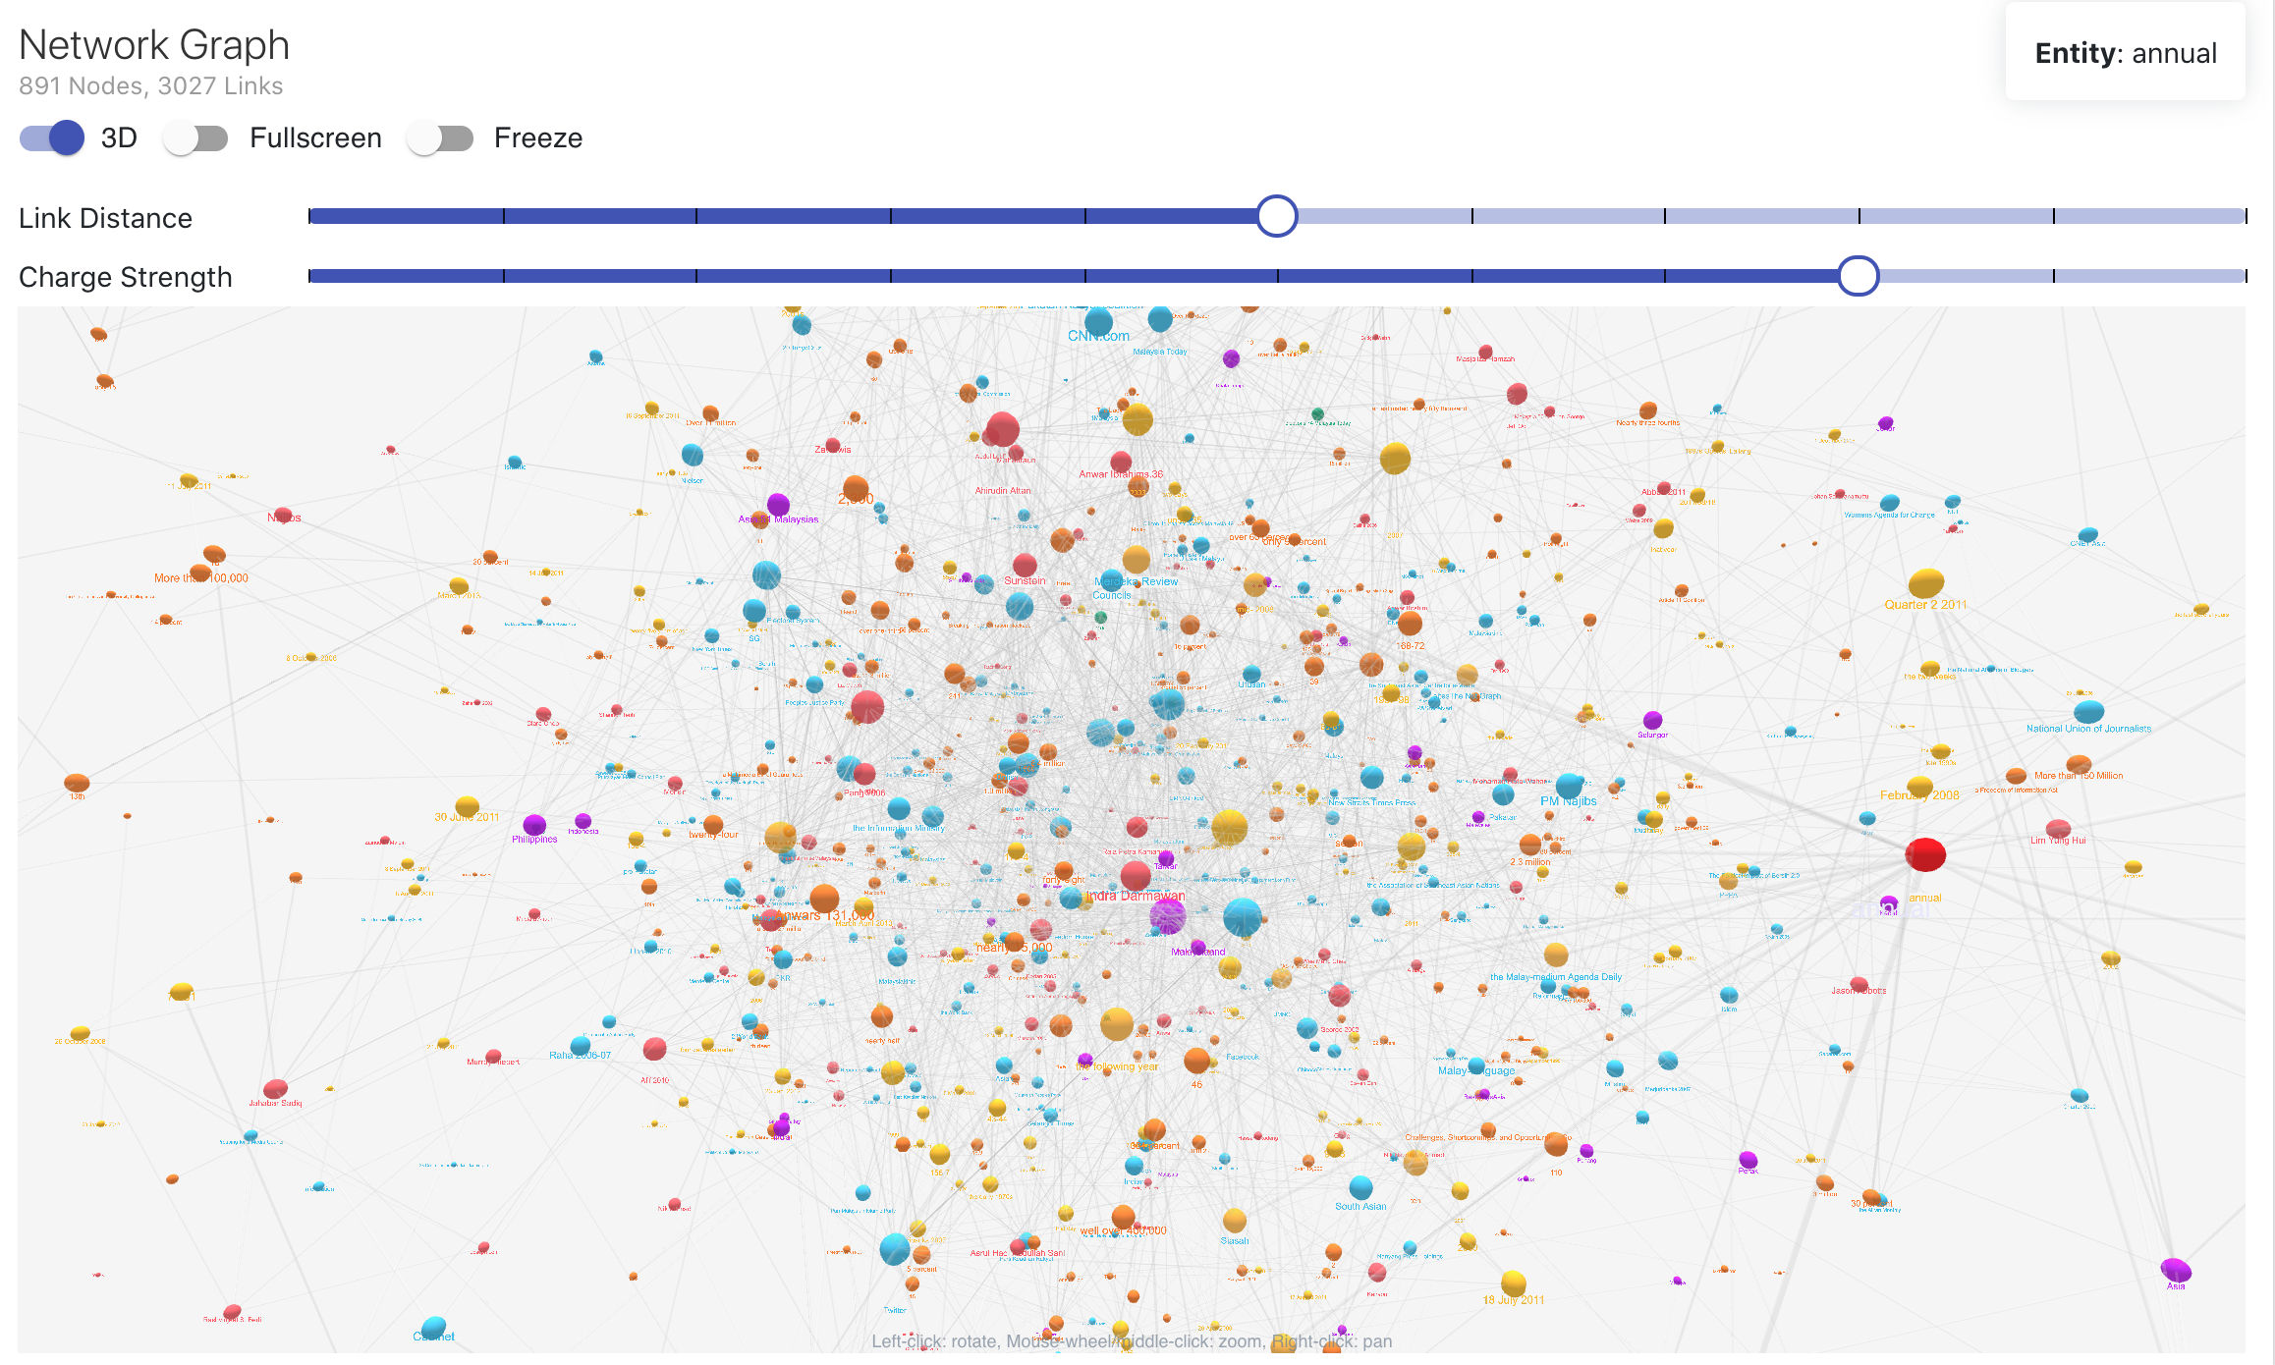
Walkthrough of Use Case
The network graph displays all the entities and relations via nodes and links respectively.
The network graph has several options available to the user - 3D mode, fullscreen mode, freezing the graph so the nodes do not move, zooming in/out, and changing the link distance and charge strength between nodes.

Slide 20
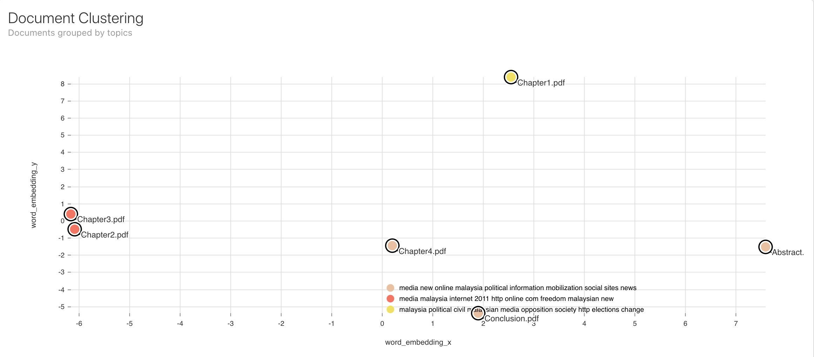
Walkthrough of Use Case
Shows how closely related each document is to each other. The closer the distance between the document node in the graph, the more similar the documents are.
Chapter 2 and 3 are similar in topic, where both are talking about media, internet in Malaysia and possibility its impact on freedom

Slide 21
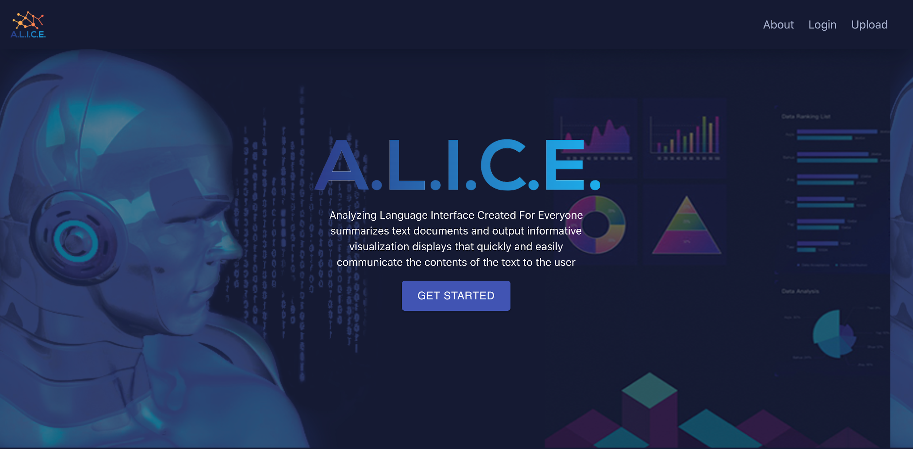
Live Demo
Politics in Cyberspace: New Media in Malaysia

Slide 22
Internship 2020
A.L.I.C.E.
Thank you!

Slide 23
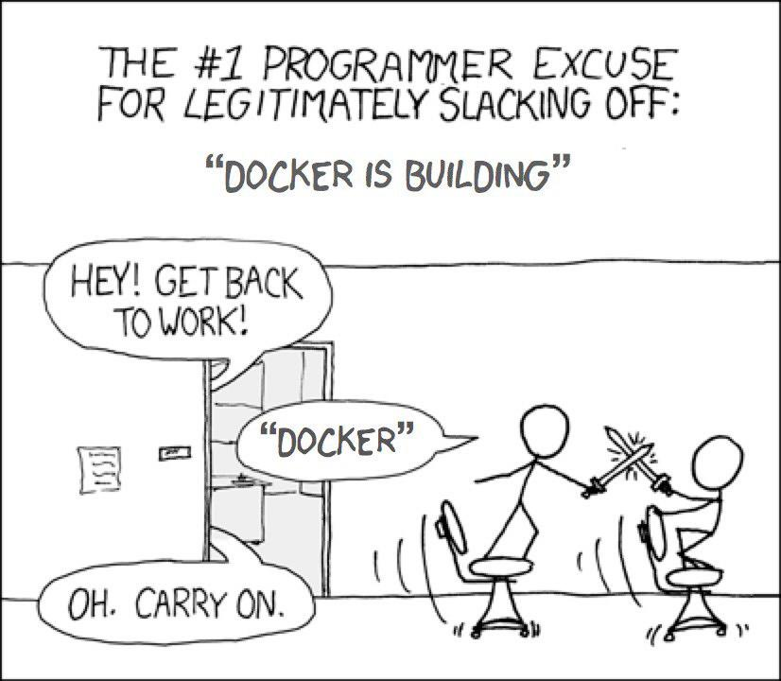

Challenges
“In school, I was taught how to read computer language. In my internship, I teach a computer how to read human language”
?
?
?
?
?

Slide 24




Learnings

Slide 25
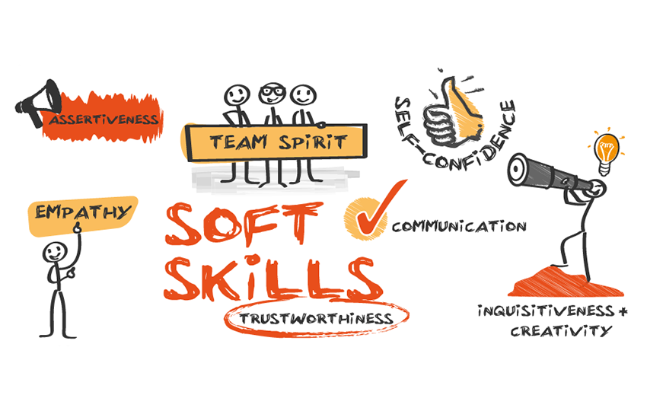
Learnings

